Slide 1
Project Carbon Cycle
Rahmat Saeedi
Michael Browne
Cole Fichter

Slide 2
Objective
Simulate carbon moving through the forest ecosystem

Slide 3
Glossary
Litter
Humus
Stable humus charcoal

Slide 4
Glossary
Humification
Carbonization

Slide 5
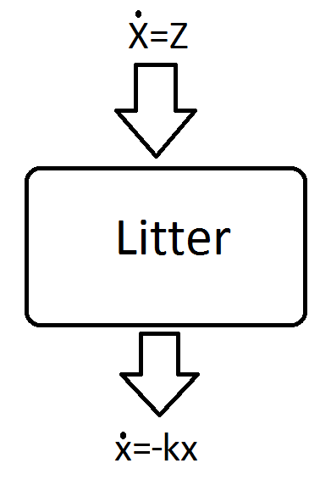
Simple Litter Model
Calculate the amount of carbon trapped in litter at any given time

Slide 6
Simple Litter Model
Begin with zero litter (after a ground fire)
Leaves & branches fall from trees at a constant rate, creating litter
Carbon exits litter by respiration and humification as litter is composted

Slide 7
Simple Litter Model
Model: one differential equation
x'(t) = z - k*x(t)

Slide 8
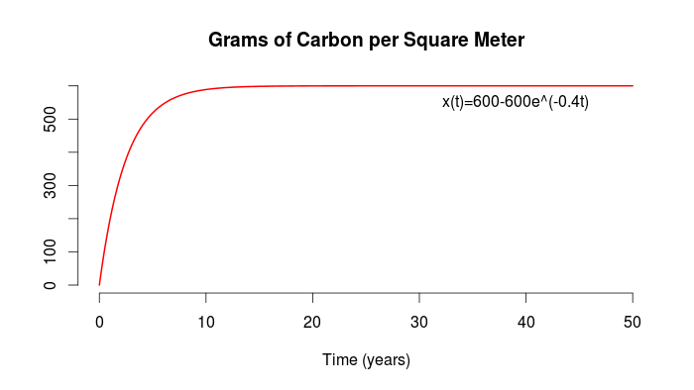
x(t) = 600 - 600*exp(-0.4t)

Slide 9
Steady States
Assume z = 240, k = 0.4
Equilibrium occurs when x'(t) = 0, so
x'(t) = 240 -0.4*x(t) <=> x'(t) = -0.4(x(t) - 600)

Slide 10
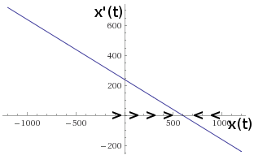
Graphical Stability Analysis

Slide 11
Simple Litter Model
Model: one differential equation
x'(t) = 240 – 0.4*x(t), and x(0) = 0
Specific Solution
x(t) = 600 - 600*exp(-0.4t)

Slide 12
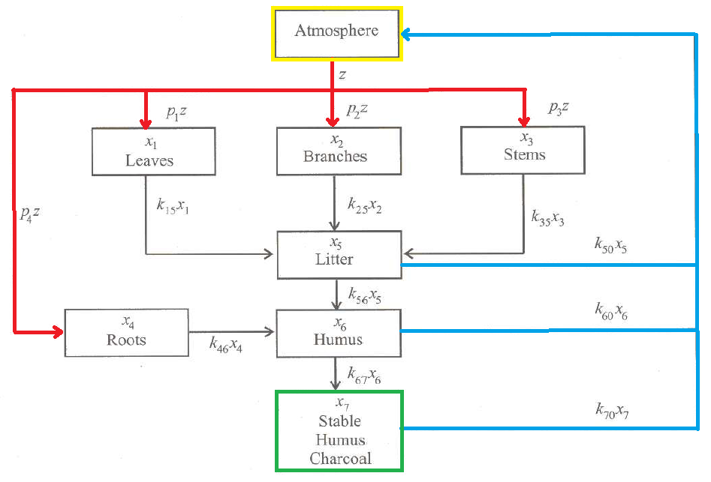
The Carbon Cycle

Slide 13
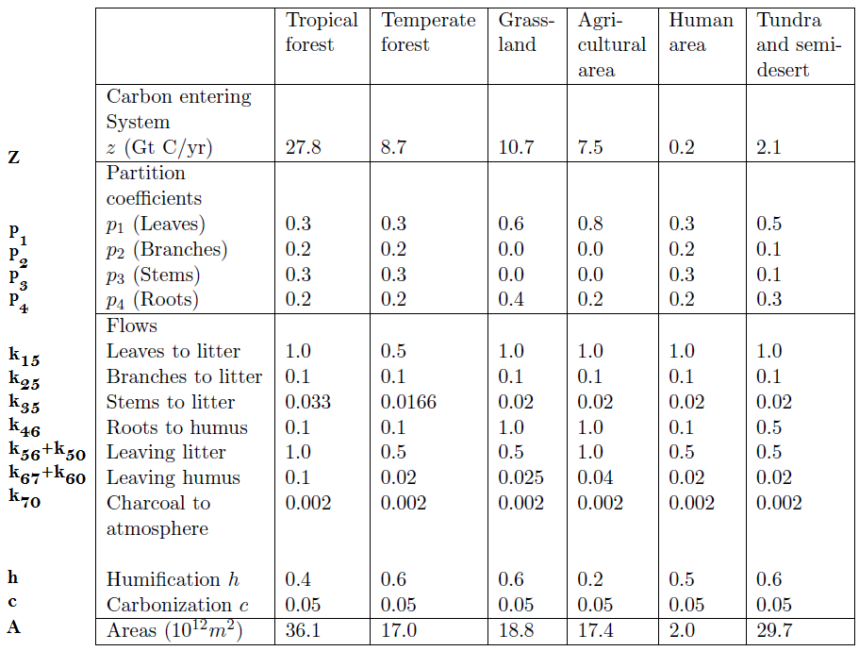
Given Data

Slide 14
D.E. Set Up
X'₁(t) = p₁z - k₁₅X₁
Leaves Atm. To Litter
X'₂(t) = p₂z - k₂₅X₂
Branches Atm. To Litter
X'₃(t) = p₃z - k₃₅X₃
Stems Atm. To Litter
X'₄(t) = p₄z - k₄₆X₄
Roots Atm. To Litter

Slide 15
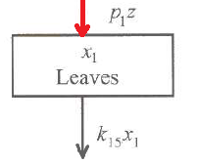
D.E. Set Up
X'₁(t) = p₁z - k₁₅X₁
Leaves Atm. To Litter
X'₂(t) = p₂z - k₂₅X₂
Branches Atm. To Litter
X'₃(t) = p₃z - k₃₅X₃
Stems Atm. To Litter
X'₄(t) = p₄z - k₄₆X₄
Roots Atm. To Litter

Slide 16
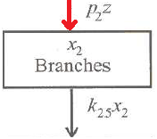
D.E. Set Up
X'₁(t) = p₁z - k₁₅X₁
Leaves Atm. To Litter
X'₂(t) = p₂z - k₂₅X₂
Branches Atm. To Litter
X'₃(t) = p₃z - k₃₅X₃
Stems Atm. To Litter
X'₄(t) = p₄z - k₄₆X₄
Roots Atm. To Litter

Slide 17
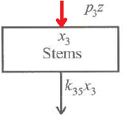
D.E. Set Up
X'₁(t) = p₁z - k₁₅X₁
Leaves Atm. To Litter
X'₂(t) = p₂z - k₂₅X₂
Branches Atm. To Litter
X'₃(t) = p₃z - k₃₅X₃
Stems Atm. To Litter
X'₄(t) = p₄z - k₄₆X₄
Roots Atm. To Litter

Slide 18
D.E. Set Up
X'₅(t) = k₁₅X₁ + k₂₅X₂ + k₃₅X₃ - k₅₆X₅ - k₅₀X₅
Litter Leaves Branches Stems Humus Atm.
X'₆(t) = k₄₆X₄ + k₅₆X₅ - k₆₇X₆ - k₆₀X₆
Humus Roots Litter Charcoal Atm.
X'₇(t) = k₆₇X₆ - k₇₀X₇
Charcoal Humus Atm.

Slide 19
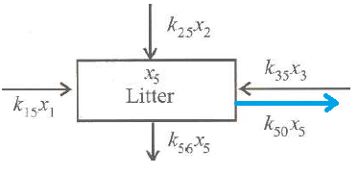
D.E. Set Up
X'₅(t) = k₁₅X₁ + k₂₅X₂ + k₃₅X₃ - k₅₆X₅ - k₅₀X₅
Litter Leaves Branches Stems Humus Atm.
X'₆(t) = k₄₆X₄ + k₅₆X₅ - k₆₇X₆ - k₆₀X₆
Humus Roots Litter Charcoal Atm.
X'₇(t) = k₆₇X₆ - k₇₀X₇
Charcoal Humus Atm.

Slide 20
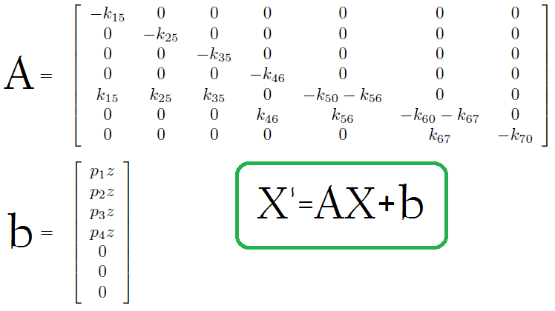
Matrix Representation of DE

Slide 21
X'=AX+b
Diagonal of A
Multiset of Eiganvalues
Fixed Points: X' = 0
0 = AX + b
AX= -b

Slide 22
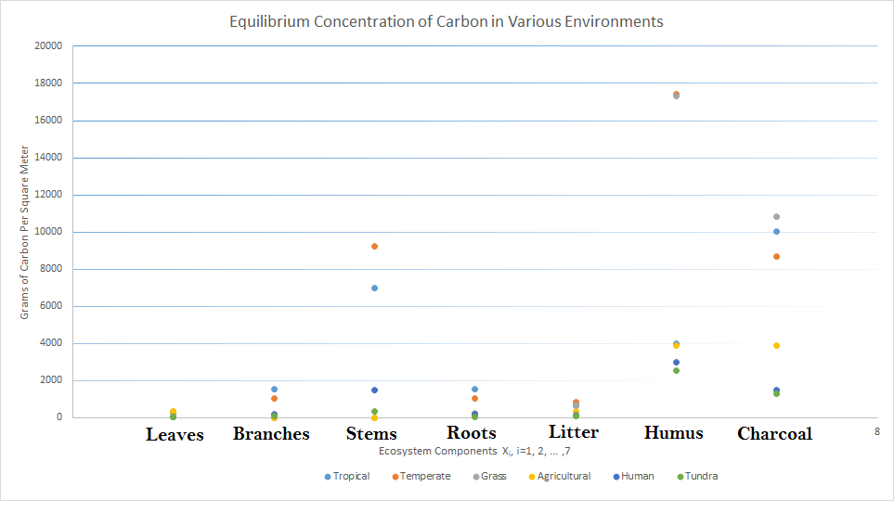
Fixed Point of The Ecosystems

Slide 23
Solution
Analytical
Maple
Matrix Exponential
X' = AX+b
X = c₁e^{At} - b/A
Numerical
Matlab
Euler Method
X(n+1) = X(n) + δt X'(n)

Slide 24
Ecosystems
1. Tropical Forests
2. Grasslands
3. Agricultural Lands

Slide 25
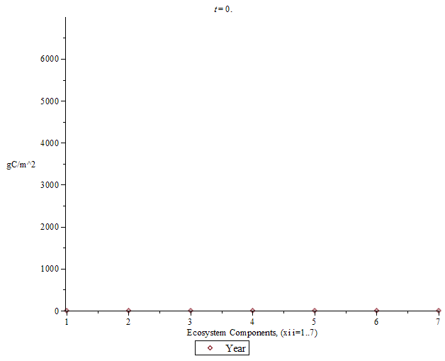
Tropical Forest: First 225 Years

Slide 26
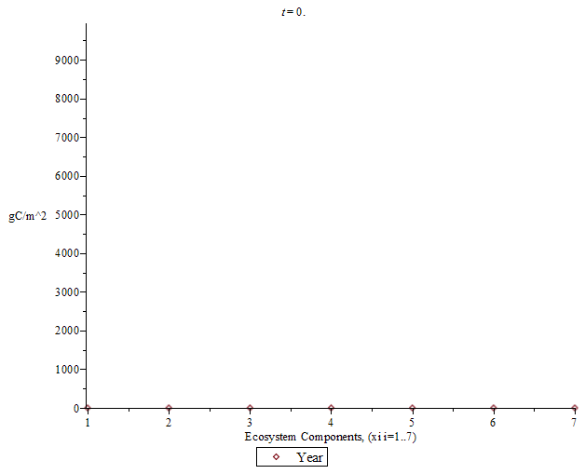
Tropical Forest: First 2500 Years

Slide 27

Grassland: First 5 Years

Slide 28
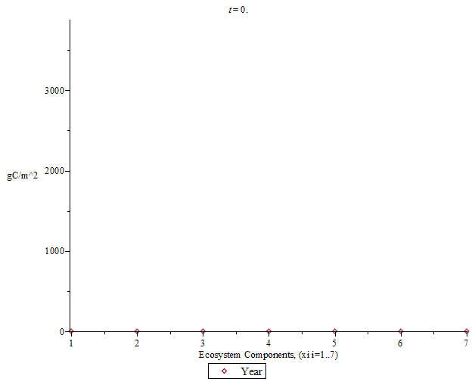
Grasslands: First 3000 Years

Slide 29
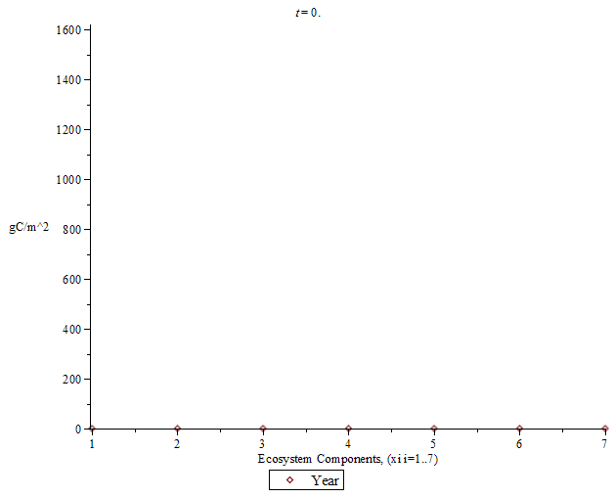
Agricultural Land: First 15 Years

Slide 30
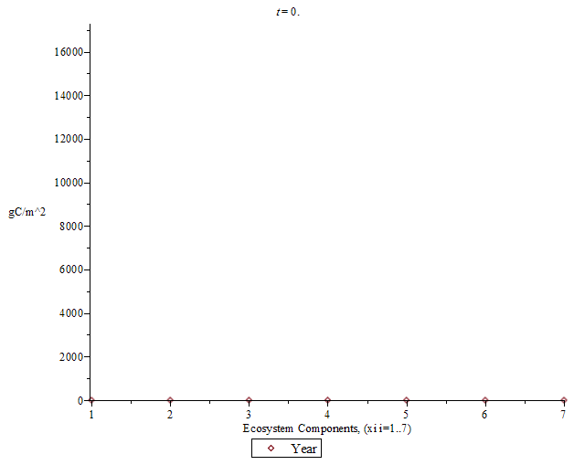
Agricultural Land: First 3000 Years

Slide 31
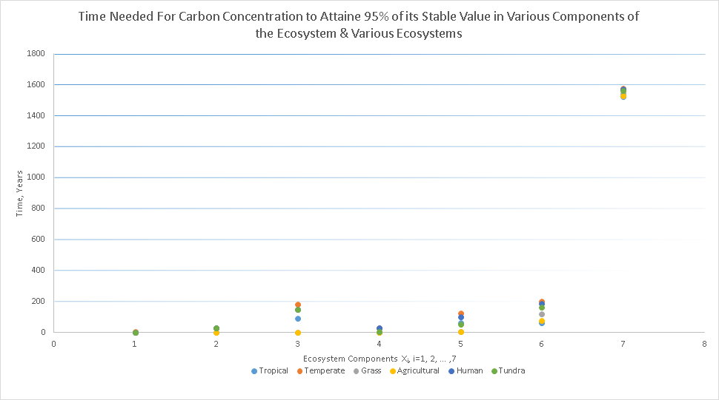
Time To Attain 95% of Fixed Point Concentration

Slide 32
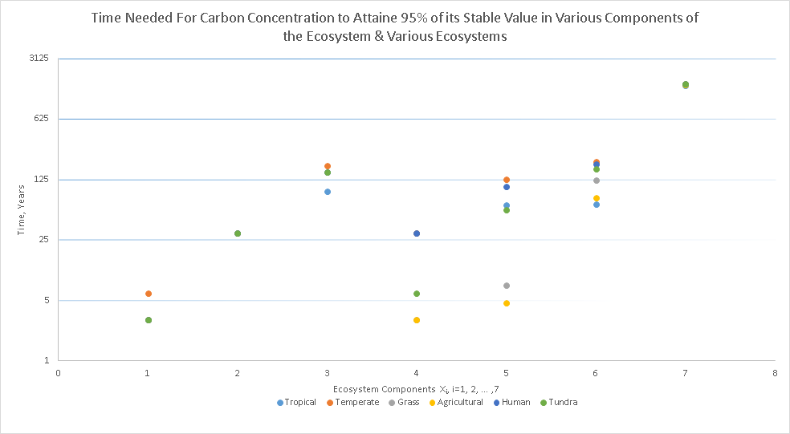
Time To Attain 95% of Fixed Point Concentration

Slide 33
Analytical Stability Analysis
•After Converting the system into its Matrix form, the stability was found from the matrix’s Eigenvalues

Slide 34
•Since all of the Eigenvalues were negative, it can be show that ANY fixed point is stable

Slide 35
•Since these Eigenvalues are linear, it can be shown that they are also not sensitive to change
•This means that the only way for instability in the system to occur, is for the flows in one subsection to reverse

Slide 36
Criticisms of the Model
•Like any mathematical model, there are errors made when creating a model for a system
•The main contributor for these errors in general is a lack of model variables

Slide 37
•For this model, the equations had not taken into account that the number of trees change with respect to how much atmospheric carbon dioxide there is

Slide 38
•Furthermore, this system is considered in isolation
•There are different types of trees in a given ecosystem and thus the values for the parameters for each part of the tree are actually functions of how many of each tree there are

Slide 39
Thanks for Your Attention
Questions

Slide 40
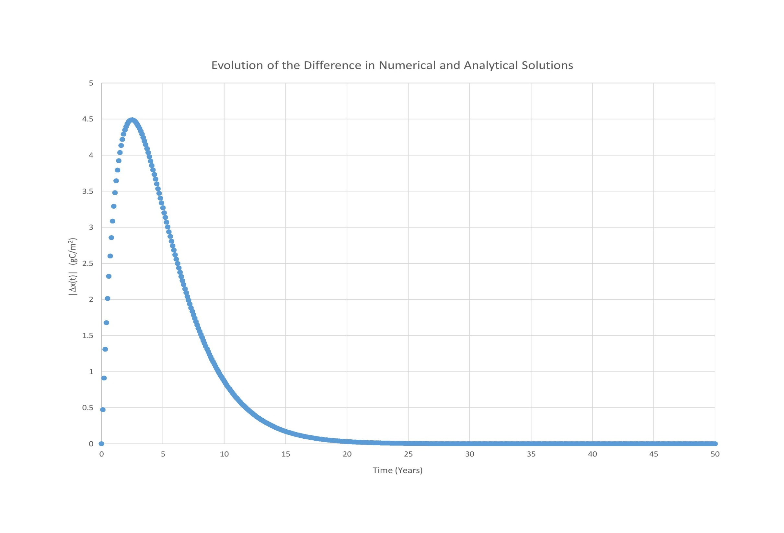
Backups: Numerical Error Propagation

Slide 41
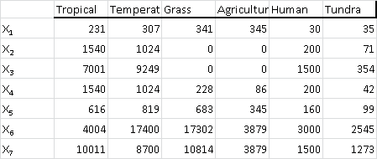
Backups: Equilibrium Density of Carbon

Slide 42
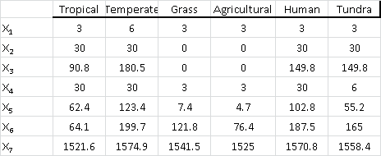
Backups: 95% Time

